Slide 1
Analyzing EEG data
fft(): Sprint: 4/2
Allison & Elizabeth

Slide 2
Amplitude vs. Frequency
Amplitude: is the size of the vibration and how loud a sound is
Energy
Frequency: is measured in Hertz (Hz)
1 Hz = one wave per cycle (sec)

Slide 3
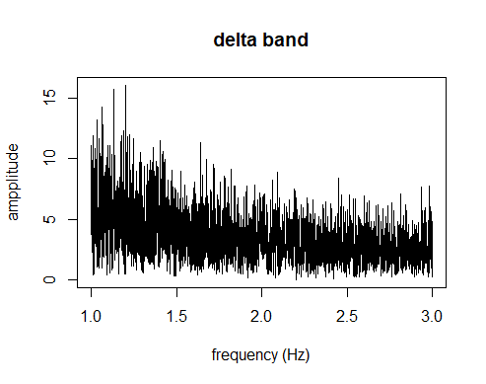
Signal Frequencies
Four main frequencies of human EEG waves are known as:
Delta: only has a max frequency of 3 Hz.
Is the highest in amplitude and the slowest of the wave types

Slide 4
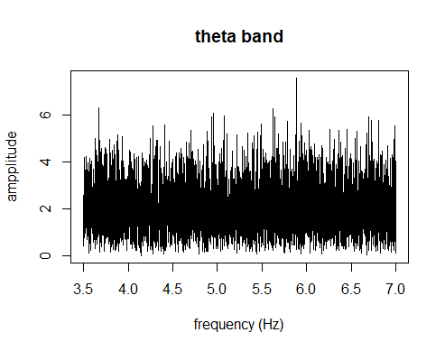
Signal Frequencies
2. Theta waves
Has a frequency range between 3.5 Hz and 7.5 Hz; very slow

Slide 5
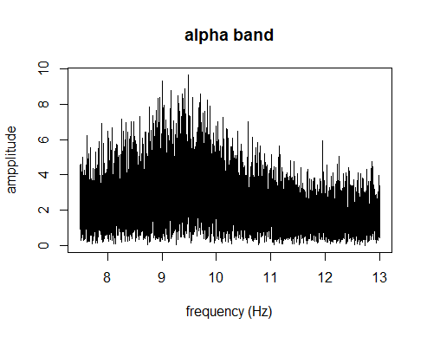
Signal Frequencies
3. Alpha waves
Has a frequency range between 7.5 Hz and 13 Hz; high amplitude

Slide 6
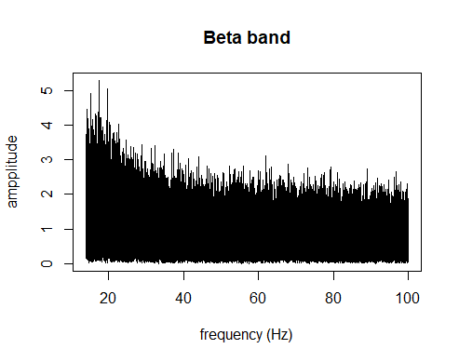
Signal Frequencies
4. Beta waves
Has a frequency range between 14 Hz and a greater value; fast activity

Slide 7
Sampling Rate
Before implementing the fft() algorithm, we must define the sampling frequency:
The sampling frequency defines the number of samples per second taken from the signal (split into time)
By taking our first signal, FP1-REF, and retrieving its rate in Hz to give us this line:
sampFreq = sig$`EEG FP1-REF`$sRate

Slide 8
Indexes to Sample At:
Need to define the time interval and the timeIndex (samplingIndex)
timeInterval = 1 / sampFreq
timeIndex = seq( 0, sec, by=timeInterval )
Specifically, generating a sequence of numbers from 0 to sec (recorded period of the signal FP1-REF)
Define the number of samples:
N = length(timeIndex) //see note

Slide 9
Plot of input Signal
Plot signals with two different frequencies or the signal itself
plot( timeIndex[1:len], inputSignal[1:len], main="EEG FP1-REF", type="l", xlab="time (sec)", ylab=sig$`EEG FP2-REF`$range )
Example with signal itself
plot( timeIndex[1:len], inputSignal[1:len], main="EEG FP1-REF", type="l", xlab="time (sec)", ylab=sig$`EEG FP1-REF`$range )

Slide 10
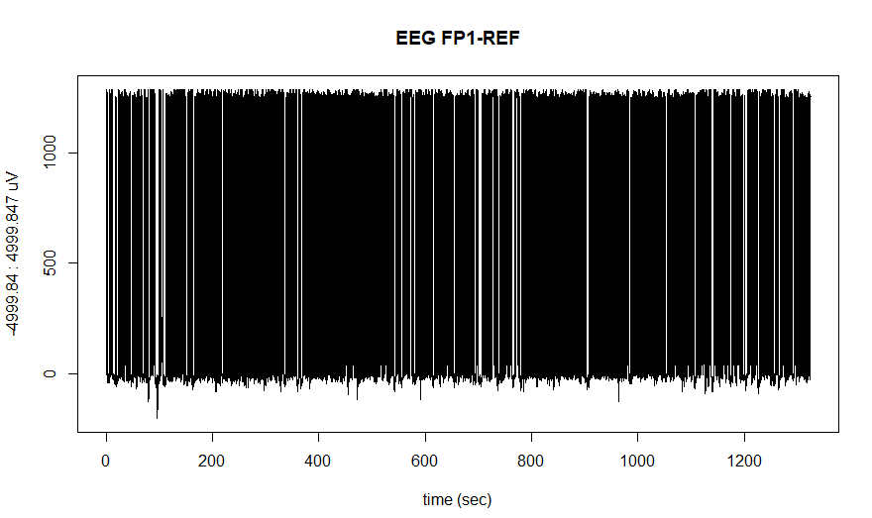

Slide 11
fft(): Fast Discrete Fourier Transform (FFT)
Fourier Analysis helps us to derive the amplitudes of each of the sine waves.
Any function can be split into simpler functions to be analyzed
The Fourier Transform can be used to filter signals
-High frequencies
Perform the fft() on the input signal FP1
fourierComponents = fft( inputSignal )

Slide 12
Absolute Value
Loud
The distance (hypotenuse) between two points
If a point is louder it will be far from the origin to the top
In R Studio need the command:
fourierCoefficients = abs( fourierComponents )
Soft

Slide 13
Normalization
Since a discrepancy arises, we must normalize the results for the sample size.
Normalize the results by N/2
normFourComp = fourierCoefficients / (N/2)

Slide 14
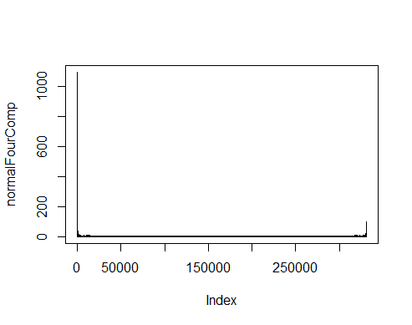
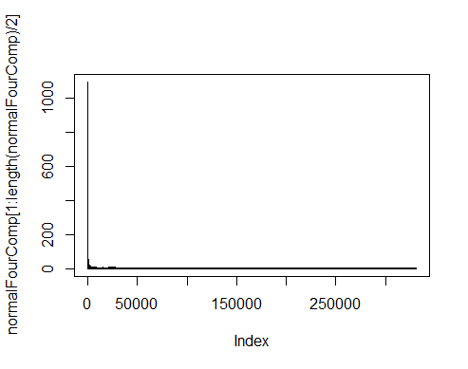
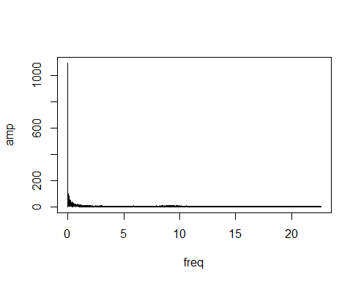
Problem with Plots for: Absolute Value, Normalization, and for first 30,000 coefficients

Slide 15
JAVA: creating code to generate repetitive R scripts
EEG FP1-REF, EEG FP2-REF, EEG F3-REF, EEG F4-REF, EEG C3-REF, EEG C4-REF, EEG P3-REF, EEG P4-REF, EEG O1-REF, EEG O2-REF, EEG F7-REF, EEG F8-REF, EEG T3-REF, EEG T4-REF, EEG T5-REF, EEG T6-REF, EEG A1-REF, EEG A2-REF, EEG FZ-REF, EEG CZ-REF, EEG PZ-REF, EEG ROC-REF, EEG LOC-REF, EEG EKG1-REF, EMG-REF, EEG 26-REF, EEG 27-REF, EEG 28-REF, EEG 29-REF, EEG 30-REF, EEG T1-REF, EEG T2-REF, PHOTIC-REF, IBI, BURSTS, BURSTS
36 total channels
Combination nCr = C(n, r) = C(36, 2) = 630 statements to write !!!

Slide 16
create ArrayList<String> of channels : ArrayList<String> channels = new ArrayList<>();
//generate correlation statements for all possible combinations C(n,r) = C(36, 2) = 630
int count = 1; //start at 1 to skip self-comparison for index position 0
for (int i = 0; i < channels.size(); i++) {
for (int j = count; j < channels.size(); j++) {
System.out.println("cor(sig$" + channels.get(i) + "$signal, sig$" + channels.get(j) + "$signal, method = 'pearson')");
}
count++; //increment count to perform correlation on count to channels.size()-1 and avoid repetition
}
Generates 360 statements to copy and paste into RStudio :)

Slide 17
Next: Common Artifacts Found in EEG Data
The purpose of EEG is to record cerebral activity. However, it also records other electrical activities other than the brain.
According to Electroencephalography, “Physiological artifacts may include cardiac, pulse, respiratory, sweat, glossokinetic, eye movement (blink, lateral rectus spikes from lateral eye movement), and muscle and movement artifacts.
How/can we remove these from the data? Can AI learn different types of graphs to determine what is and is not an artifact?

Slide 18
Next: Find the Phase Angle
Loud
The shift between two signals with the same frequency.
In R use arg() to determine the phase angle
Soft

